Slide 1


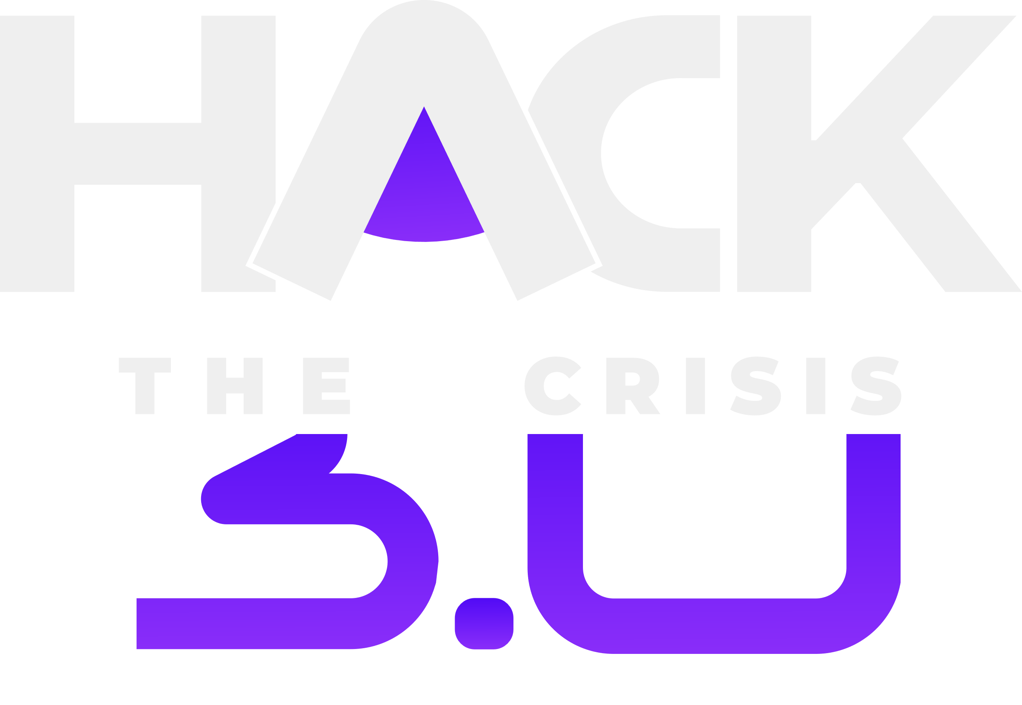

ROUND 1
SUBMISSION
Let’s Start!
Organised by - BVP ISTE

Slide 2

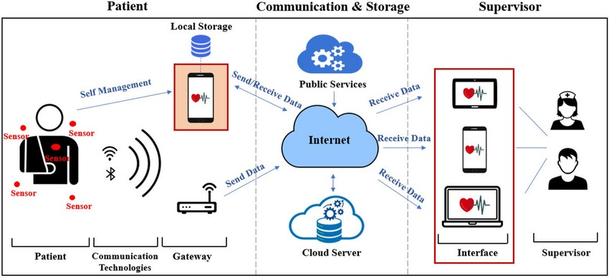
ABSTRACT
In present days, the patients belonging to rural and sub-urban communities do not maintain the diagnosis reports for which they frequently go for regular checkups wasting their valuable money. Thus, an automatic report maintaining system is to be developed to avoid repetitive diagnosis of the patients.

Slide 3

PROBLEM SOLVED
Mental Health Support Gap: Recognizing the prevalence of mental health challenges and the lack of accessible and personalized support systems for individuals facing such issues.
Isolation and Lack of Resources: Addressing the isolation and lack of resources experienced by individuals seeking mental health support, especially in remote areas or during times of crisis.
Holistic Well-being Approach: Providing a comprehensive platform that integrates mental health support with physical well-being, fostering a holistic approach to self-care and resilience.
Community Building and Support: Creating a supportive community environment where users can connect, share experiences, and access resources and expert guidance to navigate their mental health journey effectively.
A Digital Vault To Medico-HISTORY

Slide 4
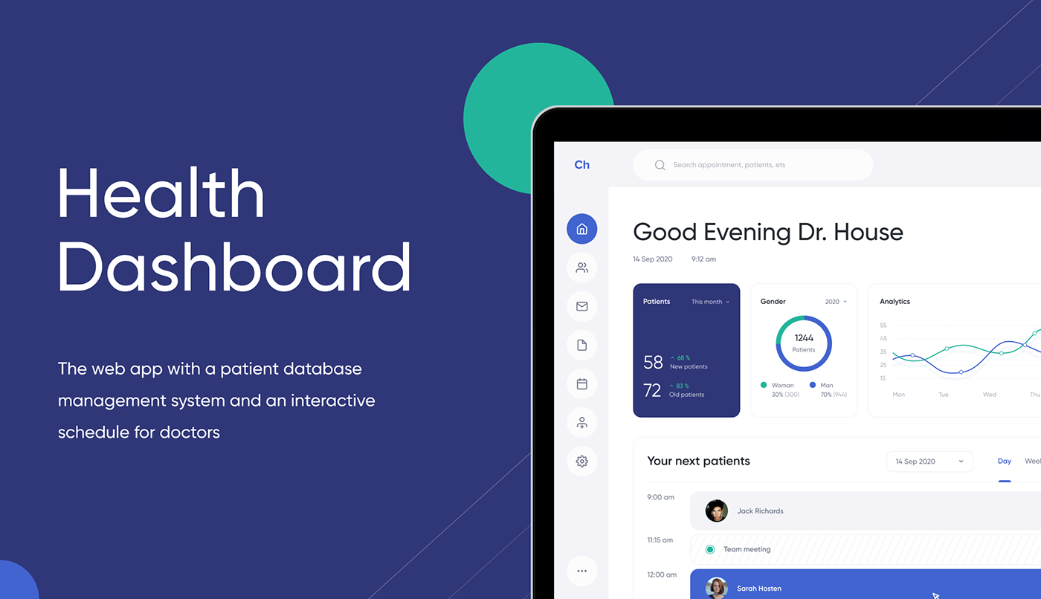
PROPOSED SOLUTION
Mobile app offering personalized mental/physiological health support.
Community forum for peer support and shared experiences.
Access to telehealth consultations with mental health professionals.
Gamification features to promote engagement and motivation.
Comprehensive health resources library for self-help and education
and vault for recording health checkups .
6. Integration of mood tracking and journaling features for self-awareness and reflection.

Slide 5

TARGET AUDIENCE
Individuals Facing Mental Health Challenges
Remote or Underserved Communities
Young Adults and Students
Working Professionals
Caregivers and Support Networks
Wellness Enthusiasts

Slide 6
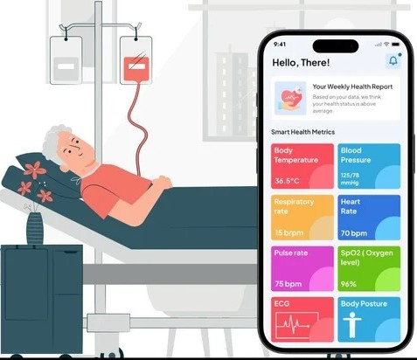
IMAGES (IF ANY)

Slide 7
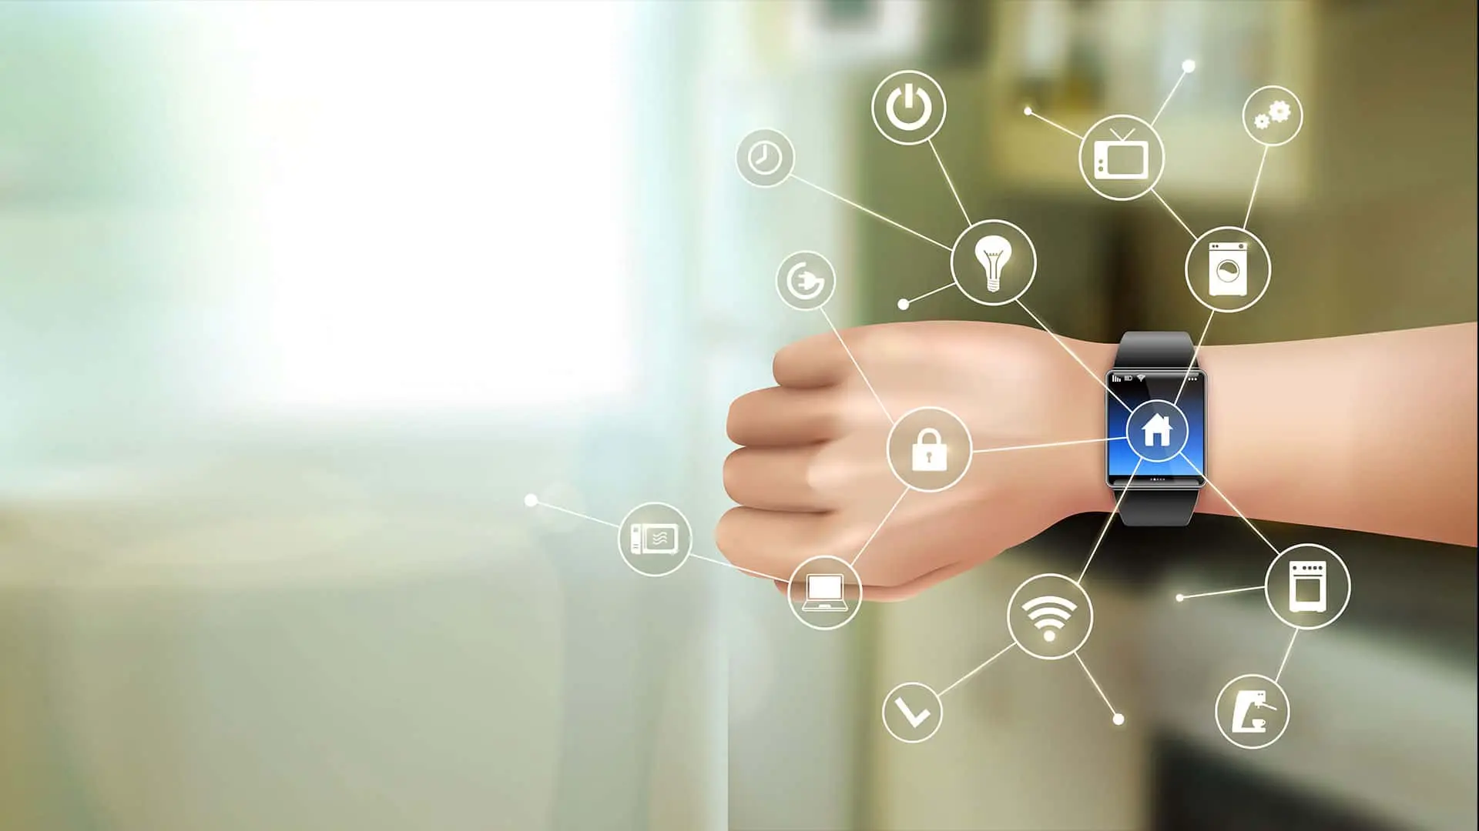
FUTURE SCOPE
1. Expansion of Features: Continuously enhance and expand the platform's features and capabilities to address evolving user needs and emerging trends in mental health and well-being.
2.Integration with Wearable Devices
3.AI-driven Personalization
4. Telehealth and Counseling Services
5. Gamification and Engagement
6. Data Analytics and Insights
7. Accessibility and Inclusivity

